Slide 1

ART TEMPLATE
iLife生活记录册界面展示
MANAGE TIME AND MONEY FOR YOU.
袁博伦 袁达强 林小龙

Slide 2
C O N T E N T S
THE TEMPLATE DESIGN BY JIUJIU.
主界面
子界面
界面关系
本次分工

Slide 3

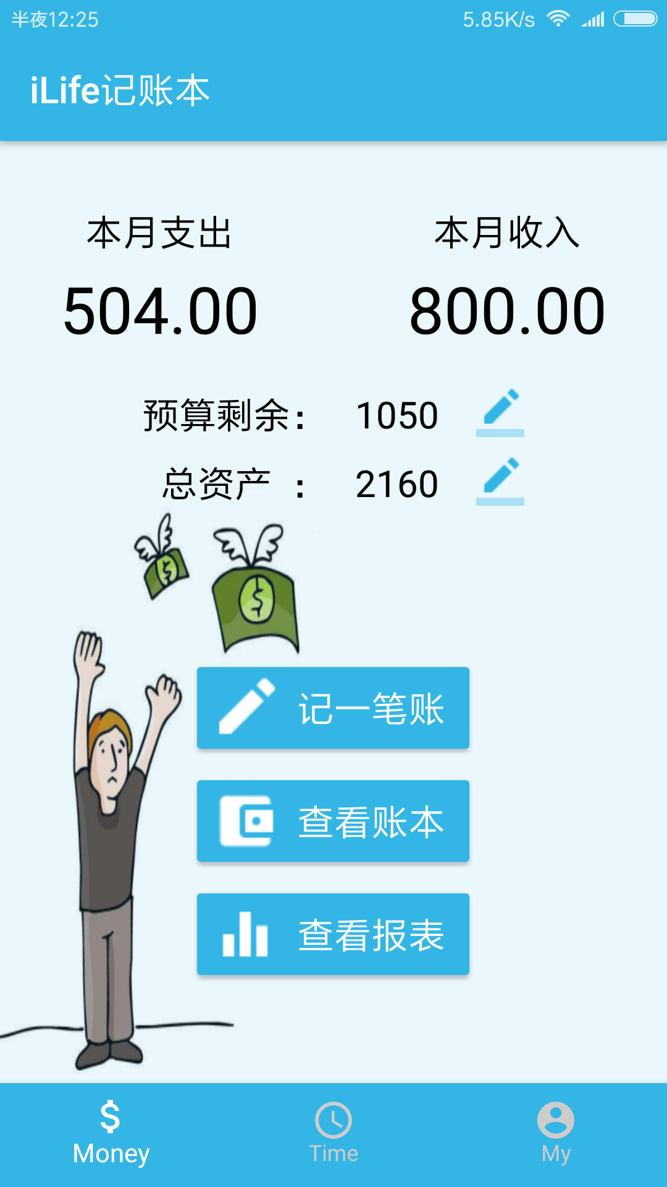
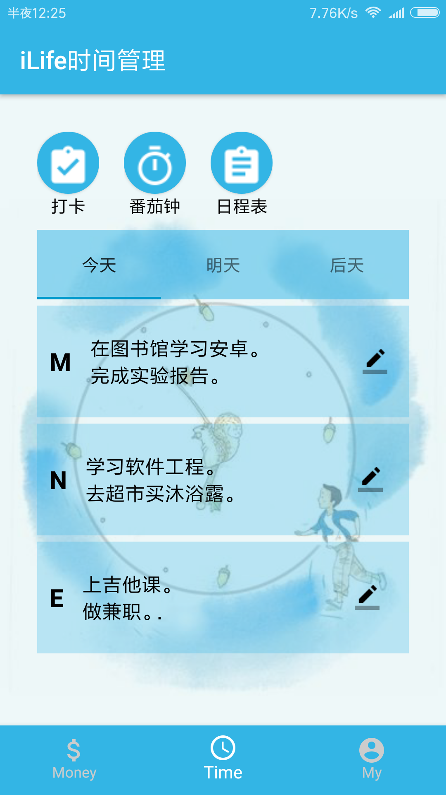
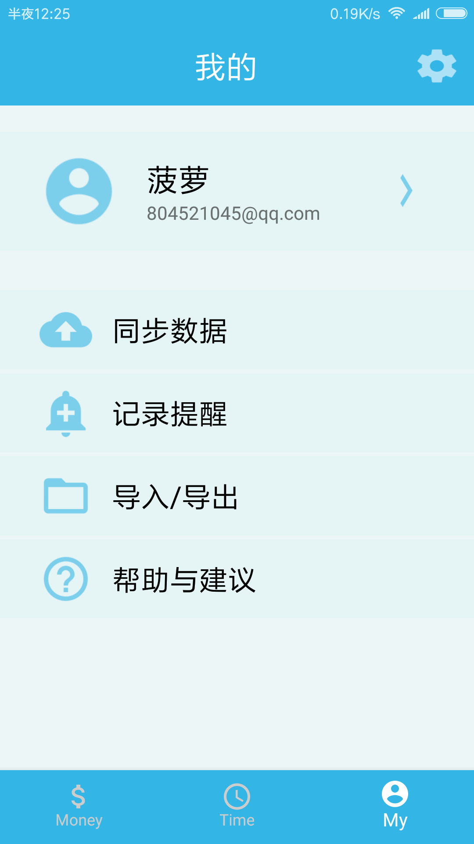
01
主界面
Made by Android Studio.

Slide 4

iLIfe记账本
THIS IS A account book .Hope you like it.
three ways. I will do somebody a good turnJust for today I will try to live through this day only and not tackle my three ways. I will do somebody a good turnJust for today I will try to live through this day only and not tackle my
three ways. I will do somebody a good turnJust for today I will try to live through this day only and not tackle my three ways. I will do

Slide 5
01
查看日程
Just for today I will try to live through this day only and not tackle my whole life at once.
编辑日程
02
iLife 时间管理
Just for today I will try to live through this day only and not tackle my whole life at once.
Just for today I will try to live through this day only and not tackle my whole life problem at once. I can do for twelve hours that
每日打卡
03
Just for today I will try to live through this day only and not tackle my whole life at once.
番茄时间
04
Just for today I will try to live through this day only and not tackle my whole life at once.

Slide 6
THIS IS A REMO TEMPLATE ,THANK YOU WATCHING THIS ONE
My
Here to set your account.
Just for today I will try to live through this day only and not tackle my whole life problem at once. I can do for twelve
hours that Just for today I will try to live through this day only and not tackle my whole life problem at once. I can do for twelve hours that

Slide 7
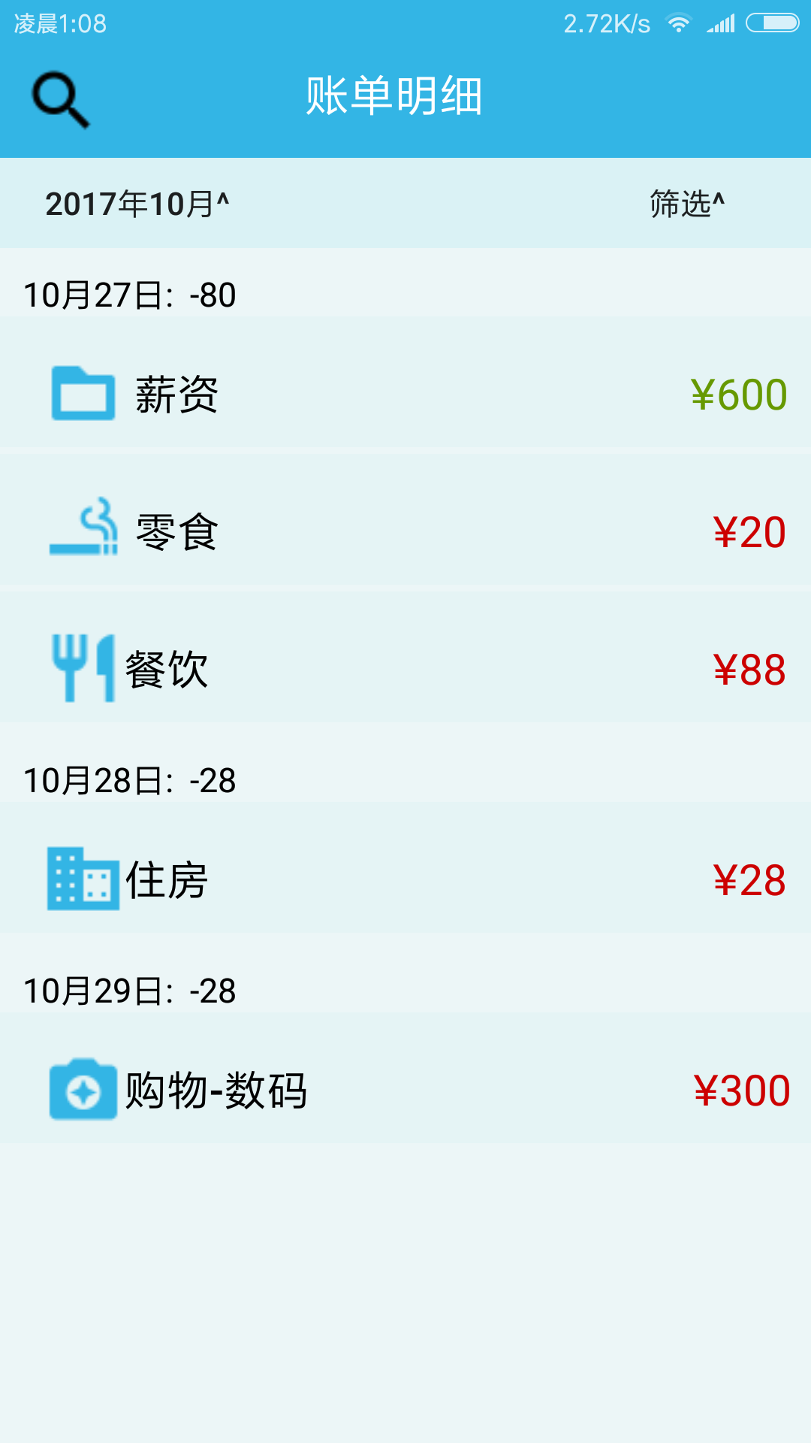
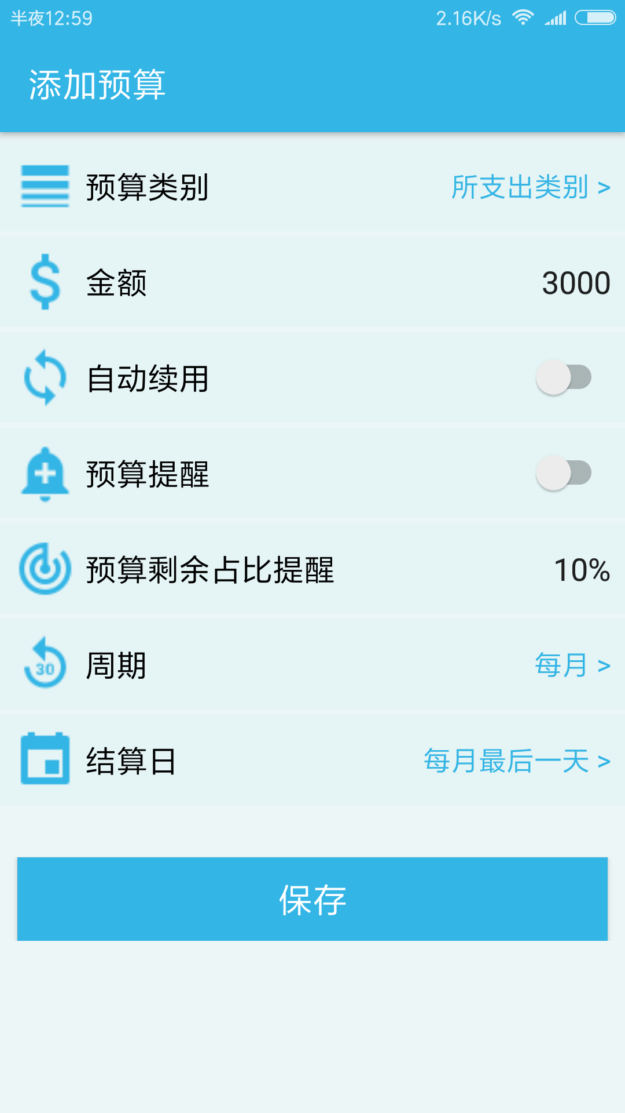
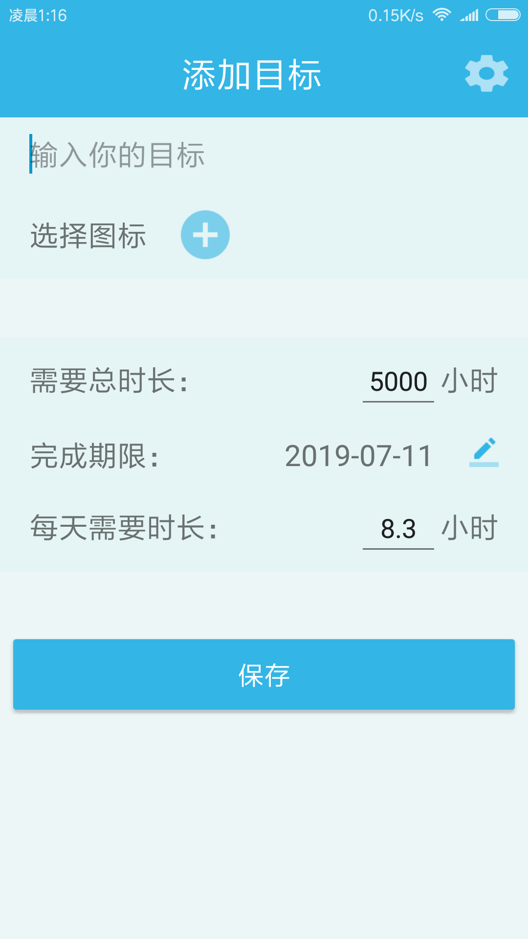
02
子界面
Made by Android Studio. Just for today I will try to live through this day only and not tackle my whole life at once.

Slide 8
Check account book
The waves beside them danced; but they Just for today I will exercise my soul in three ways.
Edit budget
The waves beside them danced; but they Just for today I will exercise my soul in three ways. I will do somebody a good turn

Slide 9
04
任务分工
Just for today I will try to live through this day only and not tackle my whole life at once.

Slide 10
UI设计、制作分工
THIS IS A ART TEMPLATE ,THANK YOU WATCHING THIS ONE
袁博伦、袁达强、林小龙
袁博伦
界面模块划分、主题配色确定
主界面设计与实现（记账本、时间管理、My界面）
各界面整合
PPT制作
袁达强
林小龙
记账本子界面设计与实现
图片素材搜集
时间管理模块子界面设计与实现
界面动态效果优化

Slide 11
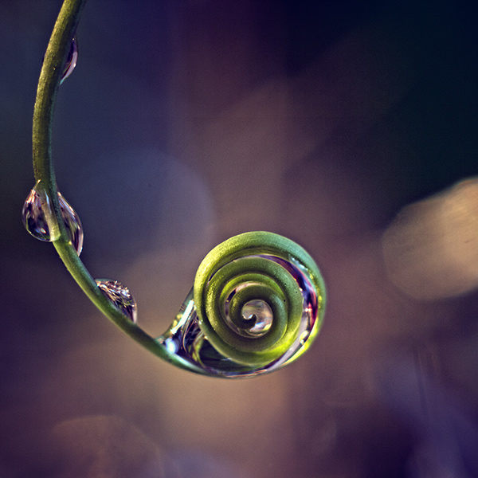
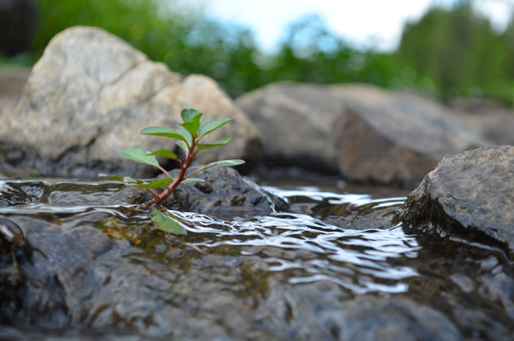
Thank you
Just for today I will try to live through this day only and not tackle my whole life at once. I can do Just for today I will try to live through Just for today I will try to live through this day only and not tackle my
Just for today I will exercise my soul in three ways. I will do somebody a good turnJust for today I will exercise my soul

Slide 12

TITTLE HERE
TITTLE HERE
The waves beside them danced; but they Out-did the sparkling waves in glee: A poet could not but be gay The waves beside them danced; but they Out-did the
TITTLE HERE
The waves beside them danced; but they Out-did the sparkling waves in glee: A poet could not but be gay The waves beside them danced; but they Out-did the sparkling waves in glee: A poet could not but be gay The waves beside them danced; but they Out-did the sparkling waves in glee: A poet could not but be gay

Slide 13
TITTLE HERE
leave night , Not a sound from the pavement Has the moon lost her memory She is smiling alone In the lamplight leave night , Not a sound
leave night , Not a sound from the pavement Has the moon lost her memory She is smiling alone In the lamplight leave night , Not a sound
leave night , Not a sound from the pavement Has the moon lost her memory She is smiling alone In the lamplight leave night , Not a sound

Slide 14
UI设计、制作分工
THIS IS A ART TEMPLATE ,THANK YOU WATCHING THIS ONE
袁博伦、袁达强、林小龙
袁博伦
界面模块划分、主题配色确定
主界面设计与实现（记账本、时间管理、My界面）
ADD YOUR TITTLE HERE
ADD YOUR TITTLE HERE
Just for today I will try to live through this day only and not tackle my whole life problem at once. I can do for twelve hours that
Just for today I will try to live through this day only and not tackle my whole life problem at once. I can do for twelve hours that

Slide 15

ADD YOUR TITTLE
Just for today I will try to live this day only and not tackle my whole life problem at Just for today I will try to live this day only and not tackle my whole life problem at
ADD YOUR TITTLE
Just for today I will try to live this day only and not tackle my whole life problem at
ADD YOUR TITTLE
Just for today I will try to live this day only and not tackle my whole life problem at
ADD YOUR TITTLE
Just for today I will try to live this day only and not tackle my whole life problem at

Slide 16
ADD YOUR TITLE
Just for today I will exercise my soul in three ways. I will do somebody a good turn
The waves beside them danced; but they Just for today I will exercise my soul in three ways. I will do somebody a good turn

Slide 17
05
ADD YOUR TITTLE HERE
Just for today I will try to live through this day only and not tackle my whole life at once.

Slide 18
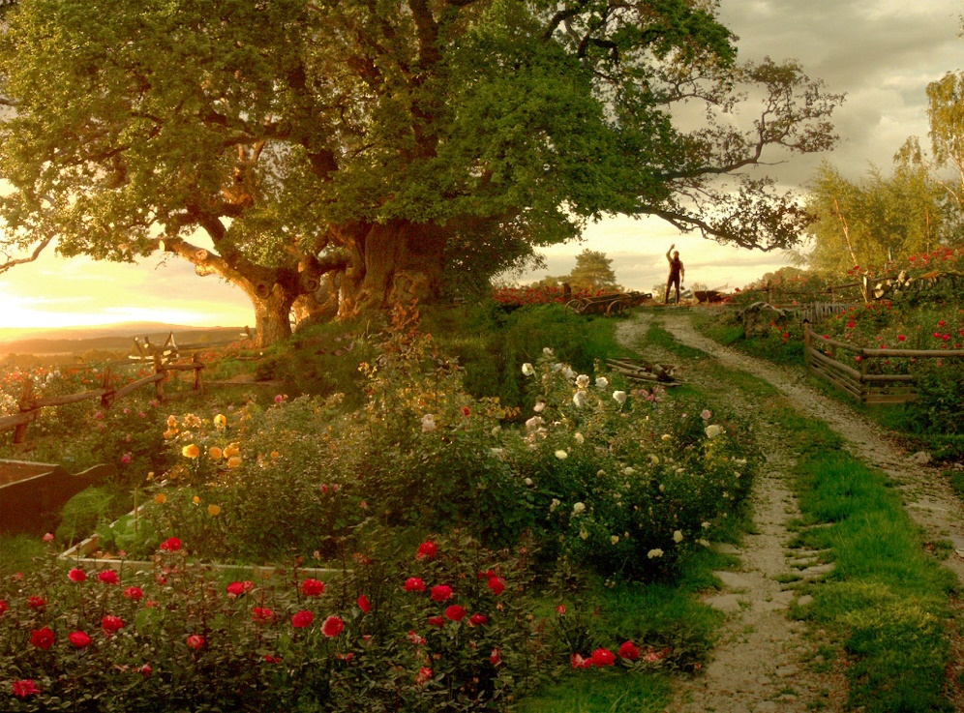
THIS IS A ART TEMPLATE ,THANK YOU WATCHING THIS ONE
Just for today I will try to live through this day only and not tackle my whole life problem at once. I can do for twelve
hours that Just for today I will try to live through

Slide 19
leave night , Not a sound from the pavement Has the moon lost her memory She is smiling alone In the lamplight leave night , Not a sound
ADD YOUR TITTLE
ADD YOUR TITTLE
Just for today I will exercise my soul in three ways. I will do somebody a good turn
Just for today I will exercise my soul in three ways. I will do somebody a good turn
ADD YOUR TITTLE
ADD YOUR TITTLE
Just for today I will exercise my soul in three ways. I will do somebody a good turn
Just for today I will exercise my soul in three ways. I will do somebody a good turn

Slide 20
ADD TITTLE HERE
THIS IS A REMO TEMPLATE ,THANK YOU WATCHING THIS ONE
hours that Just for today I will try to live through this day only and not tackle my whole life problem at
Creativity is the key to success in the great and primary education
Creativity is the key to success in the great and primary education
Creativity is the key to success in the great and primary education

Slide 21

感 谢 聆 听
THIS IS A ART TEMPLATE ,THE TEMPLATE DESIGN BY JIUJIU. THANK YOU WATCHING THIS ONE.

